Slide 1
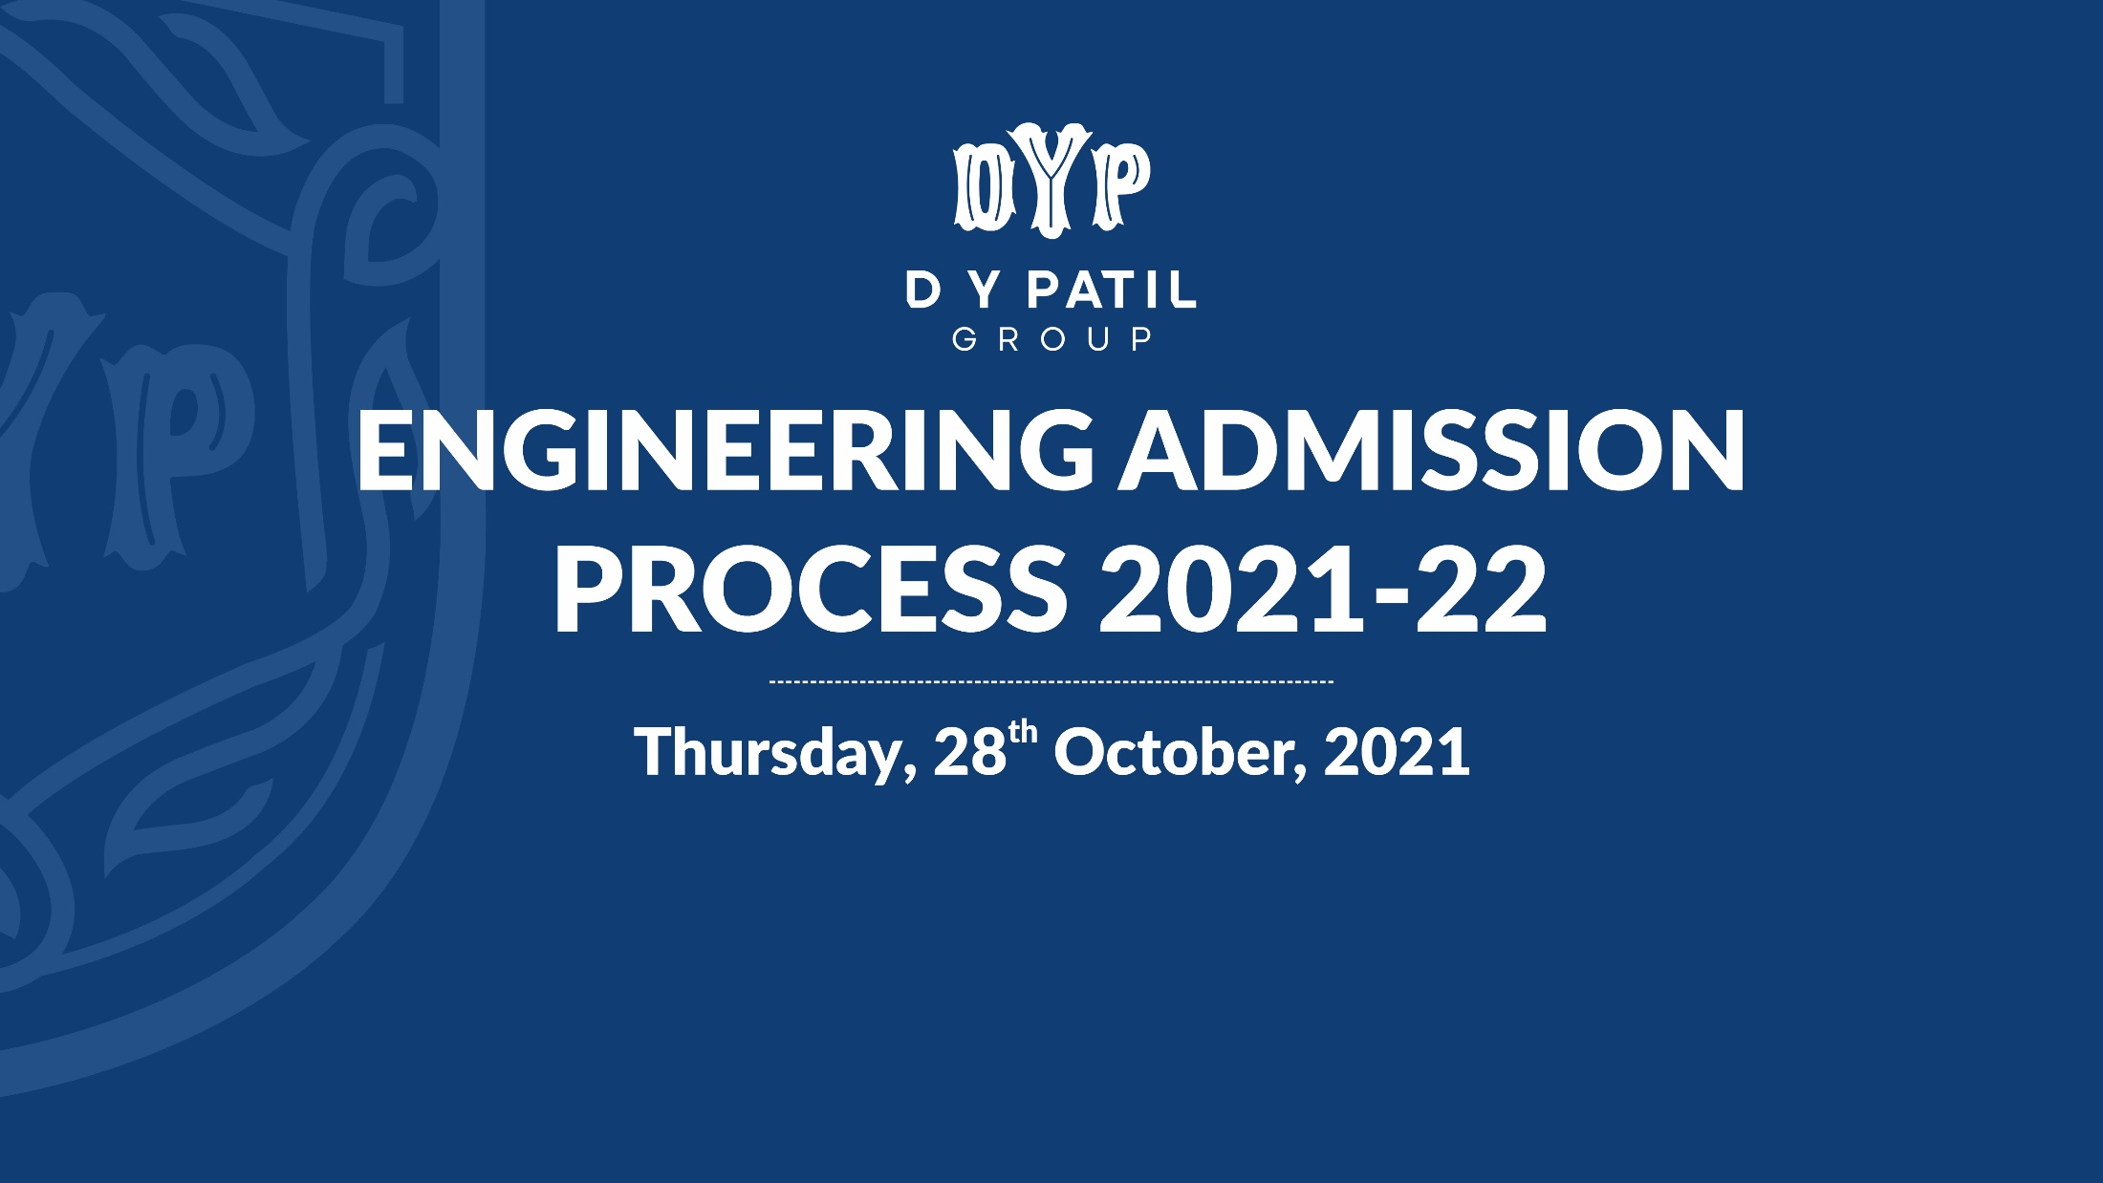


28th October 2021
Cordially welcome you for a seminar on
ENGINEERING ADMISSION PROCESS 2021-22
Speakers
Dr. A. K. Gupta
Executive Director, D. Y. Patil Group
Shri. Kunal Y. Patil
Admission Expert State,
CET Cell, Mumbai.

Slide 3

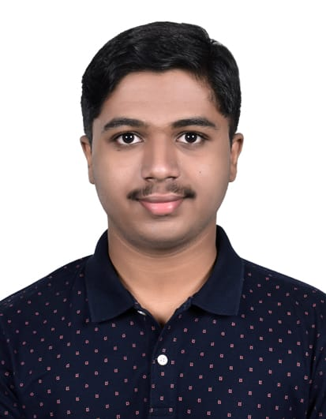
Heartly Congratulations
on your Excellent Success and Achievement in MHT-CET 2021
Wishing you the Best for your Future Endeavours
Best Wishes from
Tapan Avinash Chiknis
secured First Position with 100.00 Percentile in MHT-CET 2021

Slide 4

Engineering Admissions 2021-22
Dr. Anilkumar Gupta
Executive Director, DYP Group, Kolhapur.

Slide 5

Outlines of Presentation
Myths about Engineering Education
Career Opportunities after Engineering
What is Engineering and Various Branches of Engineering
Seat Distribution and Reservation Policy
What is TFWS and EWS
Various Scholarships available for Students from Government
Documents Required for Admission
Analysis of MHT-CET 2021
Last year Cutoff of Some Institutions
Centralized Admission Process (CAP) 2021-22

Slide 6

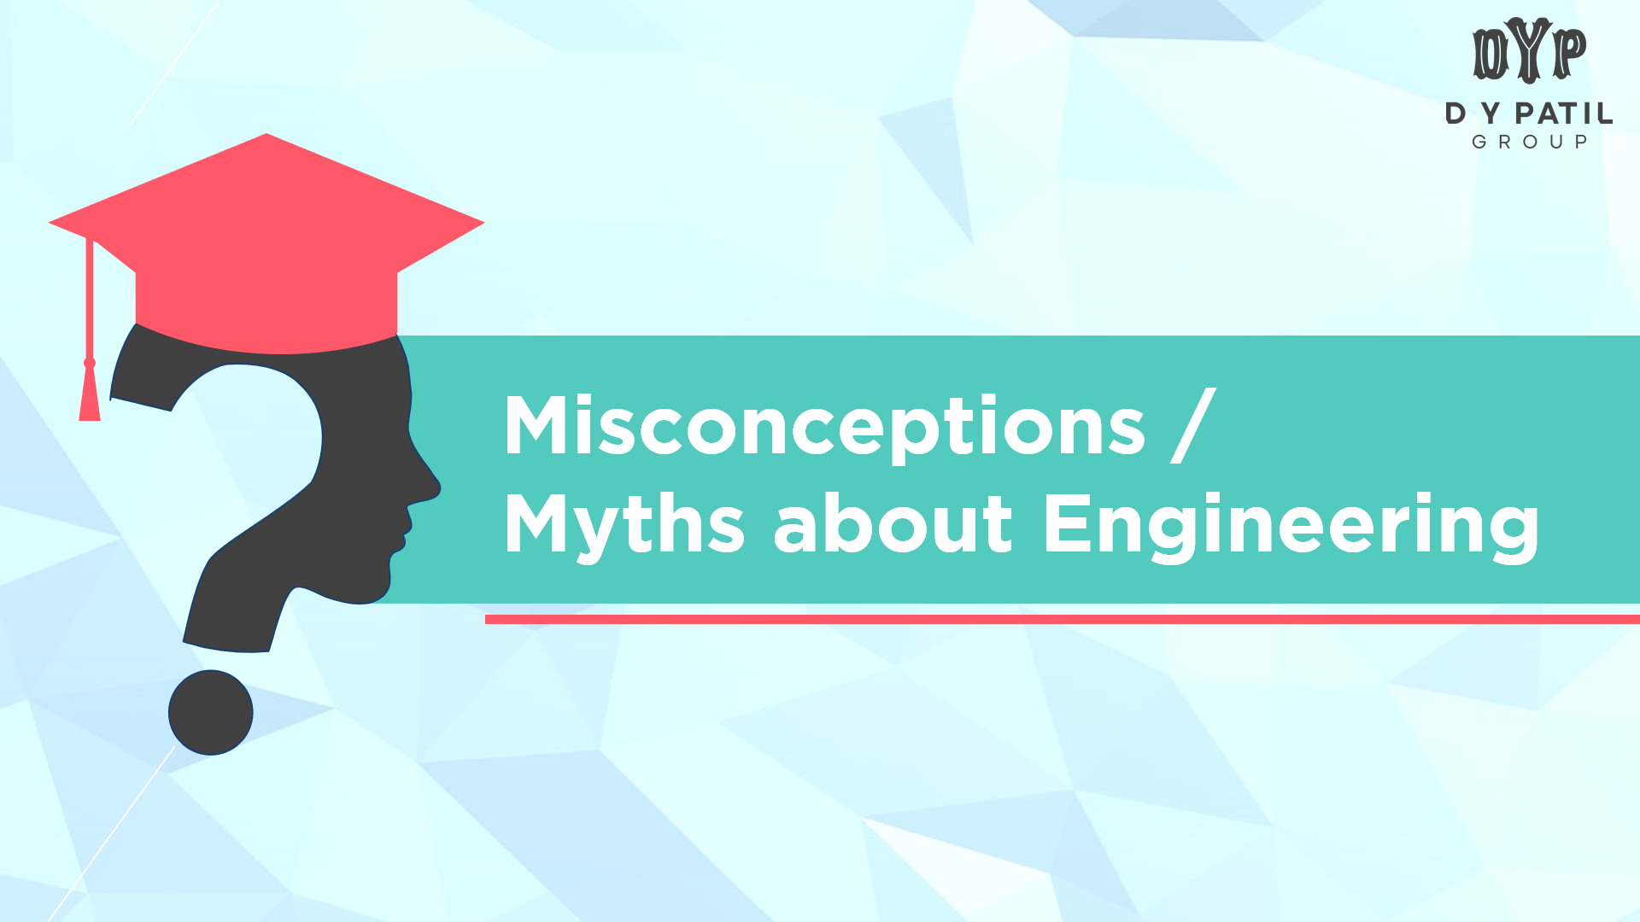
Misconceptions / Myths about Engineering

Slide 7

Misconceptions / Myths about Engineering
Too many engineers in the market.
There are NO JOBS for engineers.
Engineering means only ‘Computer Science’.
Jobs for engineers are only in IT sector.
Engineering is men’s field.
Engineering is very costly.

Slide 8
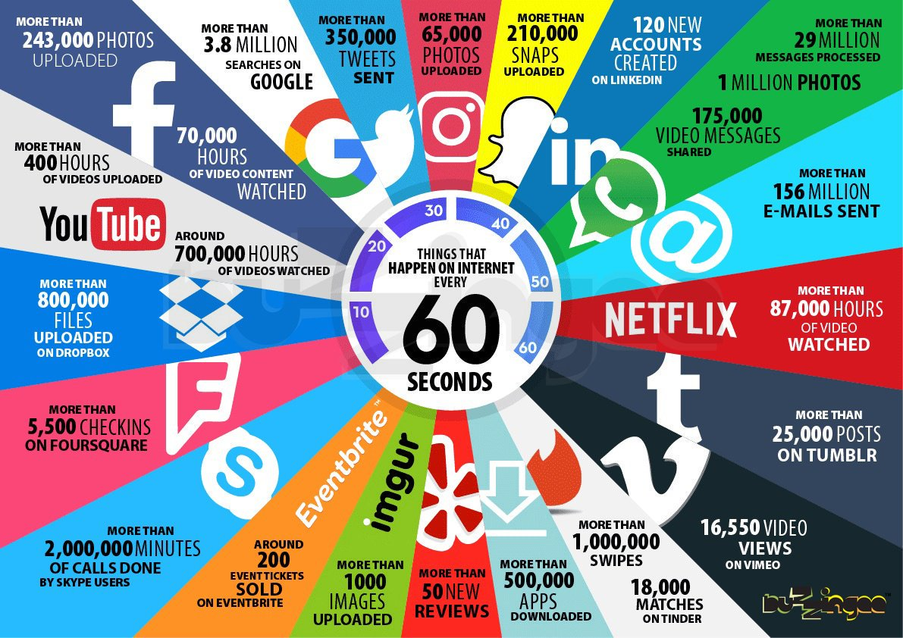
Engineering at its Best

Slide 9
Number of Students Studying in Various Streams
Values in Lacs

Slide 10
Career Opportunities after Engineering?

Slide 11
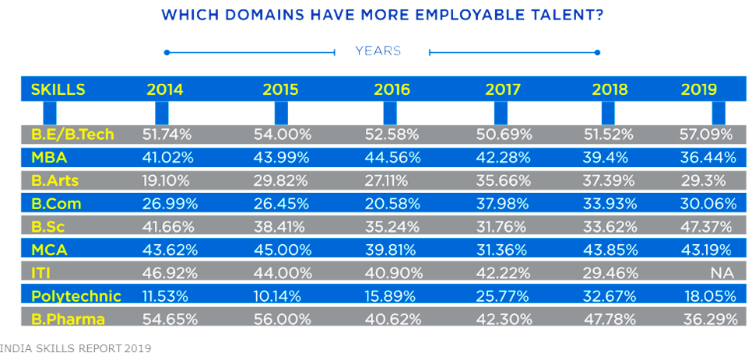
Which Domains Have More Employable Talent?

Slide 12
Facts / Reality about Engineering
 | 2017 | 2018 | 2019 | 2020
No. of Engineers Graduated | 9,67,835 | 9,44,391 | 8,75,234 | 10,23,435
Campus Placements | 3,61,201 | 3,62,571 | 3,65,342 | 3,54,000
Higher Education outside India | 86,416 | 1,02,315 | 1,08,416 | 1,50,312
GATE | 1,29,149 | 1,60,643 | 1,57,830 | 1,28,796
UPSC | 313 | 360 | 416 | 761
Armed Forces | 24,660 | 29,332 | 41,766 | 45,000
CAT / MBA in IIMs & Top B Schools | 11,313 | 12,440 | 16,716 | 18,733
Banking | 60,450 | 72,416 | 84,913 | 1,02,413
MPSC | 4,112 | 5,342 | 6,012 | ---
Total Progression | 6,77,614 | 7,45,419 | 7,81,411 | 8,00,015
% Progression | 70.01 | 78.93 | 89.28 | 78.17

Slide 13
Emerging Areas in Engineering
Big Data Analytics.
Artificial Intelligence & Data Science.
Internet of Things.
Machine Learning.
Cloud Computing.
Virtual & Augmented Reality.
Cyber Security.
Block Chain Technology.
Robotics.
Medical Electronics.
Health Care Infrastructure.
Mechatronics.
Industrial Automation.
Pharmaceutical Sciences.
Basic Infrastructure.
Non Conventional Energy.
Digital Electronics & Embedded System.

Slide 14
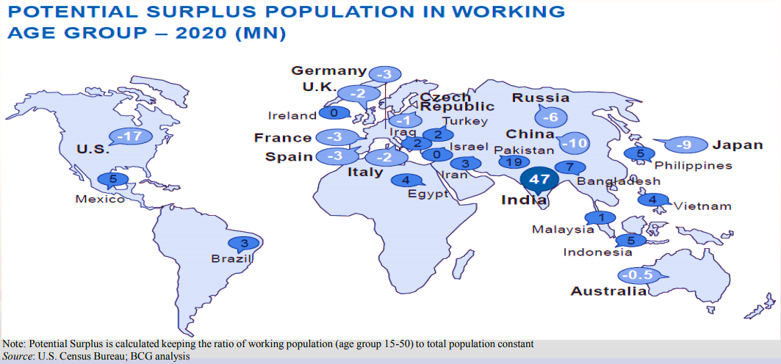
Employment Opportunities for Indians
Potential Surplus Population in working Age Group - 2021(MN)

Slide 15










Situation After COVID-19
Need of…
Building health infrastructure, India is 6th from bottom in health infrastructure.
Technology interface in health field.
App based education like –
Byju’s, Vedantu, Vidyakul, Toppr Academy, Udemy, Unacademy, Khan Academy.
Online Education.
Virtual World.
Online Shopping.
Digital Payments.
OTT Platform.

Slide 16
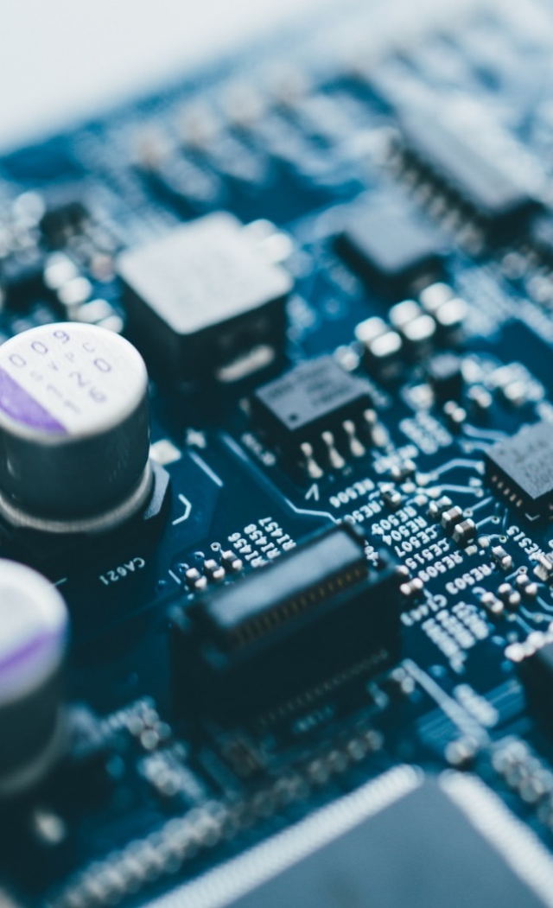
National Electronics Policies
Digital India, Smart Cities and Smart Villages.
Electronic System Design and Manufacturing.
Domestic production of mobiles.
Automation and Communication.
Total turnover of 400 billion dollars by 2025.
Total 1 crore jobs by 2025.

Slide 17
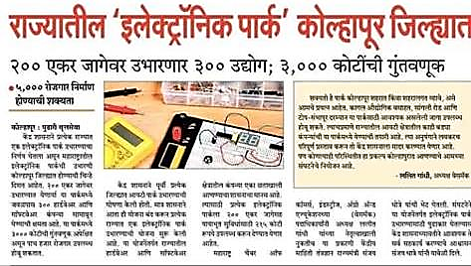
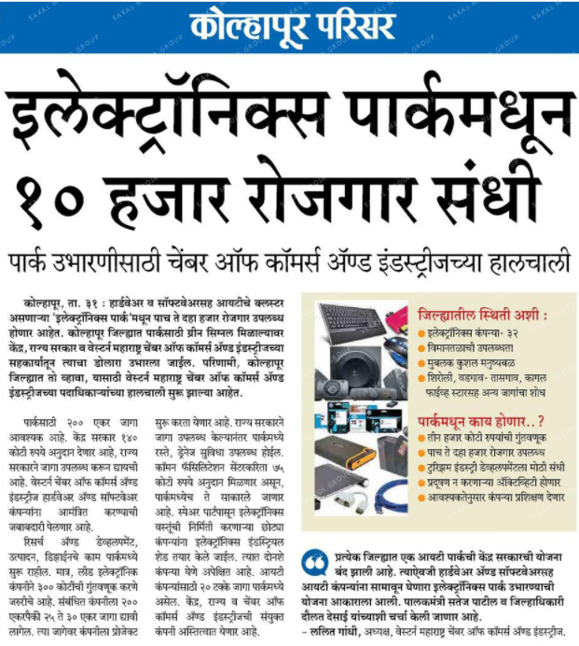
National Electronics Policies 2019

Slide 18
What is Engineering?

Slide 19


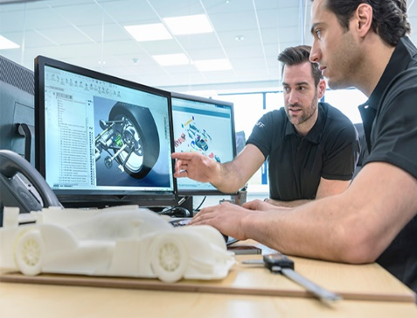


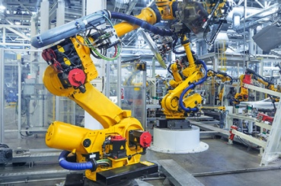

What is Engineering?
Engineering is the application of science and math to solve problems for the benefit of society.
R & D
Design
Continual Improvement
Management
Manufacturing
Logistics

Slide 20

Who are Engineers?
Engineers are Problem Solvers, Who make things –
Work Better,
More Efficiently,
Quicker,
Cheaper.

Slide 21
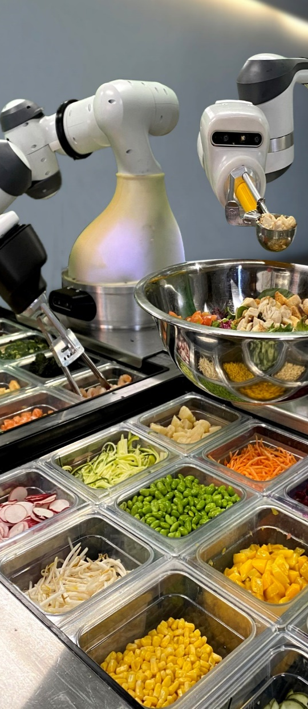
Exploring Careers in Engineering
Engineering is Everywhere…
Almost everything you eat, wear, use and like to do involves engineering…
From everyday things like your mobile, computer and clothes to medicine, space, national security & renewable energy…
To tackling climate change, providing clean drinking water or ensuring sustainable food supplies….

Slide 22
What are various Branches of Engineering?

Slide 23
Different Engineering Courses
Total of 190 different courses available in India at UG level
Basic Needs | Industrial Revolution | Development of Electricity
Civil Engineering | Mechanical Engineering | Electrical
 | Production Engineering | Electronics
Food Technology | Manufacturing Engineering | E & TC / ECE
 | Automobile Engineering | Instrumentation Tech.
Textile Engineering | Metallurgy Engineering | Medical Electronics
 | Industrial Engineering

Slide 24
Different Engineering Courses
Total of 190 different courses available in India at UG level
Information Tech. Revolution | Life Science | Specific Branches | Upcoming Branches
Computer Engineering | Chemical Engineering | Aeronautical Engineering | Robotics & Automation
Computer Science & Engineering | Bioinformatics | Marine Engineering | Artificial Intelligence Machine Learning
Information Technology | Bio – Medical Engineering | Textile | Data Science
Information Science & Engineering | Biotechnology | Petroleum Engineering | Internet of Things & Cyber Security
 |  | Paint Technology | Block chain Technology

Slide 25

Civil Engineering
Civil engineering is the oldest branch of engineering.
Civil Engineering deals with the Design, Construction and Maintenance of Structures or Public Works as they are related to earth, water or in space.

Slide 26
Civil Engineering – Streams
Rural Planning
Structural
Hydraulics
Transportation
Bridge
Environmental
Geotechnical
Earthquake
Water Resources
Construction Management
Urban Planning
Surveying

Slide 27

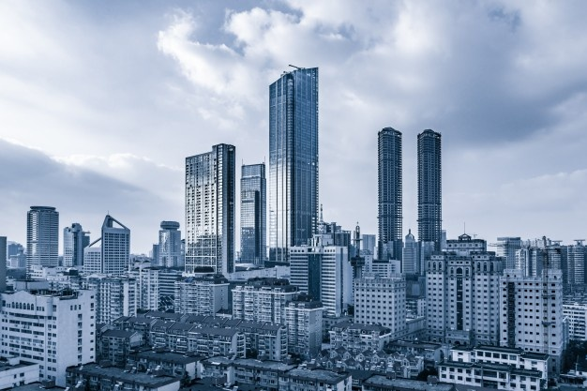
Civil Engineering Scope
Government Jobs-
UPSC
Railway
NHAI
Defense
CPWD
Public Sectors Jobs in ONGC, BPCL, HPCL, BHEL
Private Sector Job in India and Abroad
Self Employment
Higher Education
MPSC
PWD
Irrigation
ZP, Corporation

Slide 28

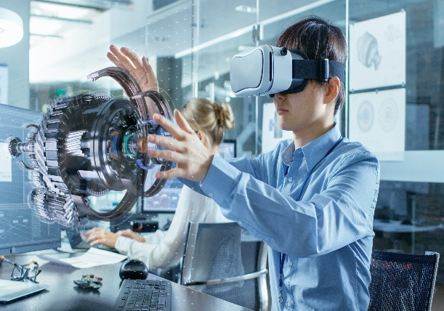
Mechanical Engineering
Mechanical Engineering applies the principles of mechanics and energy to the design of machines and devices.
Mechanical Engineer deals with Design, Operation & Maintenance of –
Machines & its Components
Machine Tools
Manufacturing Systems and Process

Slide 29
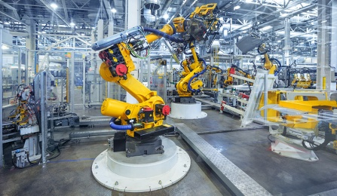
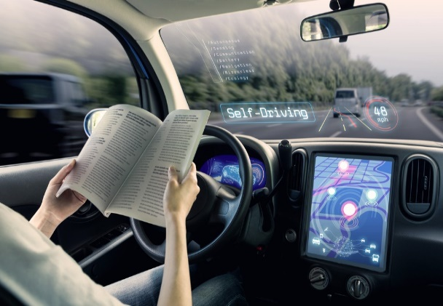
Mechanical Engineering Streams
Production
Design
Mechatronics
Automobile
Heat Power
CAD/CAM/CAE

Slide 30

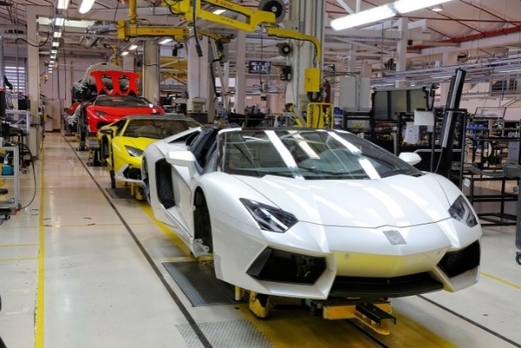
Mechanical Engineering – Scope
Engineering Industry of all kinds
Automobile Engineering
Maintenance of Plants in Process Industry
Textile, Chemical, Food processing, Pharmacy etc.
Manufacturing Sector
Armed Forces, Defense Industry, Space Research
Emerging Field of Mechatronics
Growing Areas of CAD/CAM/CAE,
Robotics & Automation
UPSC & MPSC

Slide 31

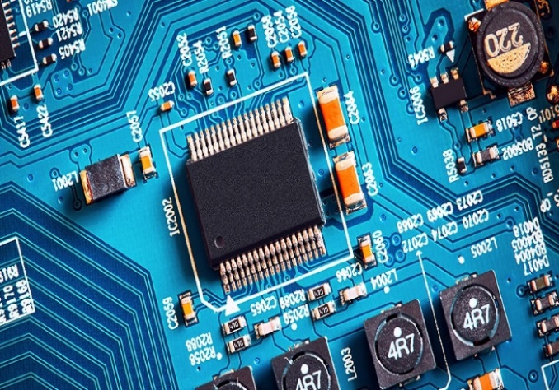
Electrical Engineering
Electrical engineering deals with the generation, transmission, distribution and use of electrical power and its control.
Electrical engineers work with equipment that produce & distribute electricity such as generators, transmission lines, transformers, lighting and wiring in buildings.

Slide 32

Electrical Engineering Scope
Any type of power plants. e.g. Atomic, Hydro, Thermal, Wind power plants.
Private and public sector like railways, civil aviation, electricity board and utility companies, electrical design and consultancy firms and all types of manufacturing industries.

Slide 33
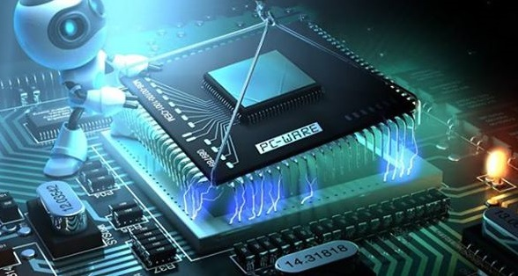

Electronics Engineering
Electronics = Electron + Dynamics.
Electrical engineers are usually concerned with using electricity to transmit energy, while Electronics engineers are concerned with using electricity to transmit information.
The main difference between electrical and electronic circuits is that electrical circuits have no decision making (processing) capability, whilst electronic circuits do.
It is a control of flow of electrons using Semi- conductor devices in circuit.

Slide 34

Electronics & Tele-Communication Engineering
It deals with transfer of Information on channel (Wired / Wireless) over short/ long distance using Electronics.
Voice, Picture and Data are some examples of Information.

Slide 35
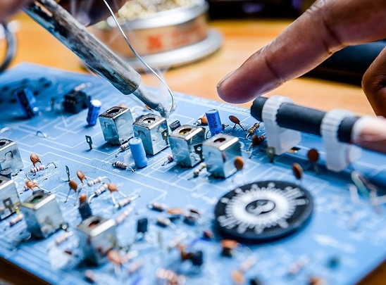
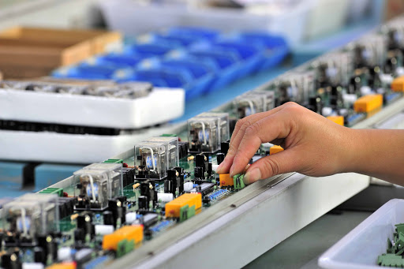
Electronics Engineering Streams -
Electronics
Electronics & Communication
Electronics & Tele-Communication
Instrumentation
Instrumentation & Control
Industrial Electronics
Bio-Medical Engineering

Slide 36
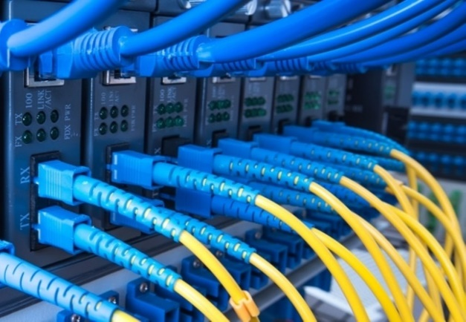
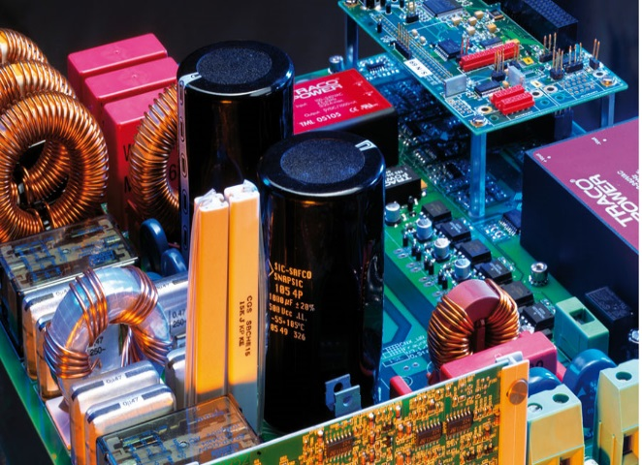
Electronics Engineering – Scope
Consumer Electronics Industry
Telecommunication industry
Space, Mobile, Wireless, Microwave, Radio Communication etc.
Networking field
Power Electronics
Opportunities in Other industries like Steel, Petroleum and Chemical Industry, Directing Control and Testing Production Process

Slide 37

Computer Science and Engineering
A Computer Engineer, also called a software engineer, is responsible for developing, testing and evaluating the software that make our computers work.
Students will learn the computer science principles that are critical to development of software, hardware and networking of computer systems.

Slide 38


Computer Science and Engineering Scope
Hardware-focused careers
IT security professional
Desktop support specialist
Network support engineer
Server/system administrator
Software-focused careers
Database designer
Application developer
E-commerce specialist
Software engineer

Slide 39



Computer Science and Engineering Scope
System Software
Application Software
Hardware & Networking
Management
Finance and Accounting
Advertisement / Marketing / Sales
Legal: Especially Cyber Law
Consultants
E-commerce
Entertainment Industry

Slide 40

Artificial Intelligence (A.I.)
Artificial intelligence (AI) is a branch of computer science concerned with building smart machines capable of performing tasks that typically require human intelligence.
Examples of AI-
Siri, Alexa and other smart assistants
Self-driving cars
Robo-advisors
Conversational bots
Email spam filters
Netflix's recommendations

Slide 41

Future of AI
Sector | Examples
Transportation | Self Driving Cars, Pilotless aircrafts, Drones
Manufacturing | AI powered Robots
Health Care | Diagnostics, drug Discovery, Virtual Nursing Assistant
Education | Digital Library, Virtual Tutors, Assessment & Monitoring of Students based on facial expressions
Social Media | Digital Marketing, Sentiment Analysis
Customer Service | Amazon, Flipkart, Snapdeal
Entertainment | AR & VR, Gaming, OTT Platforms

Slide 42

Data Science
An area that manages, manipulates, extracts, and interprets knowledge from tremendous amount of data.

Slide 43

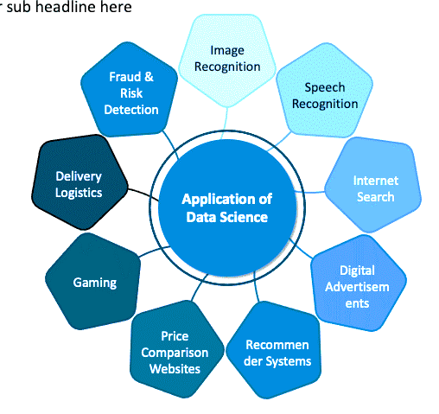
Applications of Data Science

Slide 44

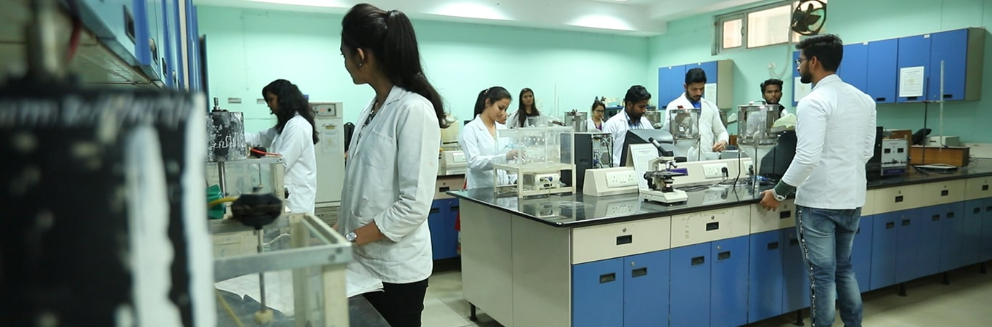
Chemical Engineering
It deals with the application of physical science (e.g. Chemistry and Physics), with Mathematics to the process of converting raw materials or chemicals into more useful or valuable forms.

Slide 45


Chemical Engineering
Chemical engineers are responsible for manufacturing of more than 70,000 products for example –
Toothpaste, Tea, Sugar, Soap, Detergents, Clothes, Plastic, Medicines, Fertilizers, Pesticides, Mosquito repellent, Cosmetics, perfumes, Alcohols, Petrol, Diesel, LPG gas, Paints, Petroleum Jelly, Asphalts… so many…

Slide 46
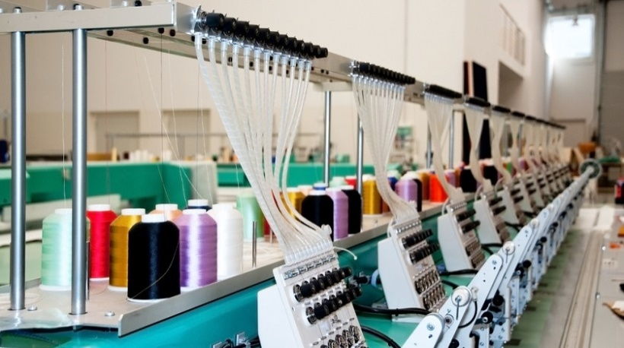
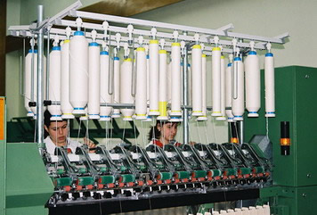
Textile Engineering
Textile engineering or textile technology deals with the design and manufacturing of fiber into yarn and yarn into fabric.
India is second largest exporter worth of $ 40 billion of textile products.

Slide 47
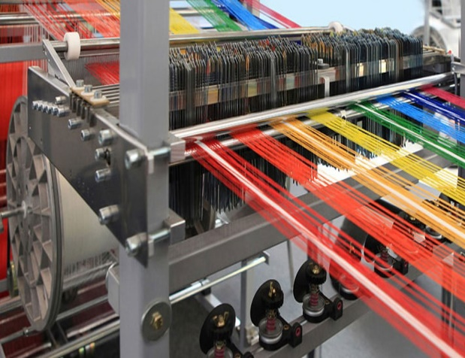
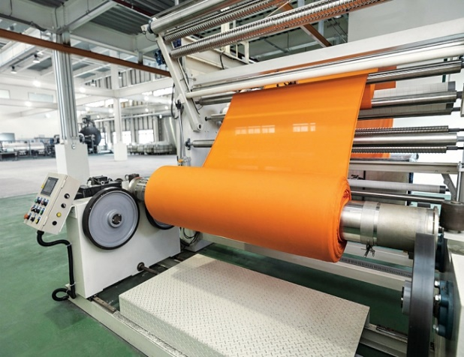
Textile Engineering – Streams
Textile Technology
Textile Chemistry
Man-Made Textile Technology
Textile Plant Engineering
Fashion Technology

Slide 48
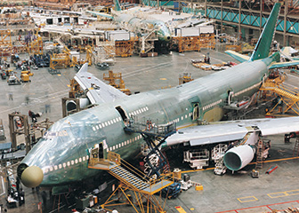

Aeronautical Engineering
It is the study that deals with researching, designing, constructing, testing and manufacturing of the aircraft.
It also deals with study of control systems of aircraft.

Slide 49

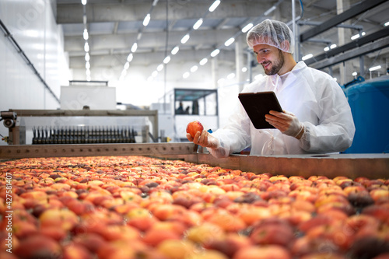
Food Technology
Food technology is the application of food science to the selection, preservation, processing, packaging, distribution, and use of safe food.
Scope of Food Technology
Food technologist
Nutritional therapist
Product/process development scientist
Quality manager
Regulatory affairs officer
Scientific laboratory technician
Technical brewer

Slide 50


Agricultural Engineering
It is the branch of engineering that deals with the design of farm machinery, the location and planning of farm structures, farm drainage, soil management and erosion control, water supply and irrigation, rural electrification, and the processing of farm products

Slide 51
Scope of Agricultural Engineering
Agro-Based Industries
Agriculture Crop Engineers
Agriculture Specialists
Agriculture Inspectors
Farm Shop Managers
Agriculture Researchers
Environmental Controls Engineers
Agronomists
Food Supervisors
Microbiologist or Plant Physiologist

Slide 52
Other Specific Branches of Engineering
Marine Engineering
Bio–Medical Engineering
Bioinformatics
Nuclear Engineering
Petroleum Engineering
Polymer Engineering
Automobile Engineering
Robotics and Automation
Mechatronics
Metallurgy Engineering
Instrumentation Engineering
Environmental Engineering

Slide 53
Eligibility Criteria for Engineering

Slide 54
Eligibility Criteria
Minimum 45% marks in Physics, Mathematics & third subject taken together (at least 40% marks, in case of Backward Class categories, Economically Weaker Section (EWS) and Persons with Disability category candidates belonging to Maharashtra State) in HSC or equivalent examination
Third Subject –
Chemistry
Biology
Biotechnology
Agriculture
Business Studies
MHT-CET 2021 or JEE Main 2021 Paper – I Score
Electronics
Computer Science
Informatics Practices
Information Technology
Technical Vocational Subject

Slide 55
Eligibility Criteria for Diploma Holders
Passed Diploma in Engineering and Technology and obtained at least 45% marks (at least 40% marks, in case of Backward Class categories, Economically Weaker Section and Persons with Disability category candidates belonging to Maharashtra State)

Slide 56
Distribution of Seats

Slide 57
Distribution of Seats
Type of Institute |  | Percentage of seats
 |  | State Level Seats | Home University Seats | Other than Home University Seats | Minority Seats | All India Level Seats | Institute Level Seats
All Government and Government aided Institutions | Autonomous | 100 | - | - | - | - | -
 | Non - Autonomous | - | 70 | 30 | - | - | -
Unaided Private Institutions | Autonomous | 65 | - | - | - | 15 | 20
 | Non - Autonomous | - | 45.5 | 19.5 | - | 15 | 20
Unaided Private Minority Institutions | Autonomous | 24.65 | - | - | 51 | 4.35 | 20
 | Non - Autonomous | - | 17.25 | 7.4 | - | 4.35 | -
ICT Mumbai |  | 70 | - | - | - | 30 | -
BATU Lonere |  | 85 | 15 | - | - | - | -

Slide 58
Distribution of Category Seats
Sr. No. | Category of Reservation | Percentage of Seats Reserved
01 | General | 50.0 %
02 | Scheduled Castes and Schedule Caste Converts to Buddhism (SC) | 13.0 %
03 | Schedule Tribes (ST) | 7.0 %
04 | Vimukta Jati (VJ) / De Notified Tribes (DT) (NT-A) | 3.0 %
05 | Nomadic Tribes 1 (NT-B) | 2.5 %
06 | Nomadic Tribes 2 (NT-C) | 3.5 %
07 | Nomadic Tribes 3 (NT-D) | 2.0 %
08 | Other Backward Classes (OBC) | 19.0 %
Total |  | 100.00 %

Slide 59
Other Reservations
Sr. No. | Category | Percentage of Seats
Over and Above Sanctioned Intake Seats (Supernumerary Seats)
01 | Economically Weaker Section (EWS) | 10.0 %
02 | Tuition Fee Waiver Scheme (TFWS) | 5.0 %
03 | Jammu and Kashmir Candidates and North East States | One Seat per Branch
Within Sanctioned Intake
01 | Sons/daughters of Defence service personnel | 5.0 %
02 | Persons with Disability | 5.0 %
03 | Orphan | 1.0 %
04 | Female Candidates | 30.0 %

Slide 60
Seat Matrix

Slide 61
Seat Matrix: Govt. Autonomous College
S.I. - 60 |  |  | MSCAP - 60 |  |  |  | AIL – 0 |  |  |  |  |  | IL - 0
Category | Open |  | SC |  | ST |  | VJ/DT |  | NTB |  | NTC |  | NTD |  | OBC |  | PH | DEF
Gen./Lad. | G | L | G | L | G | L | G | L | G | L | G | L | G | L | G | L | G | G
State | 19 | 8 | 6 | 2 | 3 | 1 | 1 | 1 | 2 | 0 | 2 | 0 | 1 | 0 | 8 | 3 | 2 | 1
HU | - | - | - | - | - | - | - | - | - | - | - | - | - | - | - | - | - | -
OTHU | - | - | - | - | - | - | - | - | - | - | - | - | - | - | - | - | - | -
S.I. - Sanctioned Intake MSCAP - Maharashtra Seats under CAP AIL- All India level seats IL- Seats to be filled by Management of respective institute G- Seats for general (both for boys and girls) L - Seats reserved for girls HU – Home University OTHU - Other than home University

Slide 62
Seat Matrix: Private Autonomous College
S.I. - 60 |  |  | MSCAP - 39 |  |  |  | AIL- 9 |  |  |  |  |  | IL - 12
Category | Open |  | SC |  | ST |  | VJ/DT |  | NTB |  | NTC |  | NTD |  | OBC |  | PH |  | DEF
Gen./Lad. | G | L | G | L | G | L | G | L | G | L | G | L | G | L | G | L | G | L | G | L
State | 12 | 5 | 4 | 1 | 2 | 1 | 1 | 0 | 0 | 1 | 1 | 0 | 1 | 0 | 5 | 2 | 2 | 0 | 1 | 0
HU | - | - | - | - | - | - | - | - | - | - | - | - | - | - | - | - | - | - | - | -
OTHU | - | - | - | - | - | - | - | - | - | - | - | - | - | - | - | - | - | - | - | -
S.I.- Sanctioned Intake MSCAP - Maharashtra Seats under CAP AIL - All India level seats IL - Seats to be filled by Management of respective institute G - Seats for general (both for boys and girls) L - Seats reserved for girls HU – Home University OTHU - Other than home University

Slide 63
Seat Matrix: Govt. College (Non Autonomous)
S.I. - 60 |  |  | MSCAP - 60 |  |  |  |  | AIL - 0 |  |  |  |  |  | IL - 0
Category | Open |  |  | SC |  | ST |  | VJ/DT |  | NTB |  | NTC |  | NTD |  | OBC |  | PH |  | DEF
Gen./Lad. | G | L |  | G | L | G | L | G | L | G | L | G | L | G | L | G | L | G | L | G | L
State | - | - |  | - | - | - | - | - | - | - | - | - | - | - | - | - | - | - | - | 1 | -
HU | 13 | 6 |  | 3 | 2 | 2 | 1 | 1 | 1 | 1 | 0 | 1 | 0 | 1 | 0 | 6 | 2 | 2 | - | - | -
OTHU | 6 | 2 |  | 2 | 0 | 0 | 1 | 0 | 0 | 0 | 1 | 1 | 0 | 0 | 0 | 3 | 1 | - | - | - | -
S.I. - Sanctioned Intake MSCAP - Maharashtra Seats under CAP AIL - All India level seats IL - Seats to be filled by Management of respective institute G - Seats for general (both for boys and girls) L - Seats reserved for girls HU – Home University OTHU - Other than home University

Slide 64
Seat Matrix: Private College (Non Autonomous)
S.I. - 60 |  |  | MSCAP - 39 |  |  |  |  | AIL - 09 |  |  |  |  |  | IL – 12
Category | Open |  |  | SC |  | ST |  | VJ/DT |  | NTB |  | NTC |  | NTD |  | OBC |  | PH |  | DEF
Gen./Lad. | G | L |  | G | L | G | L | G | L | G | L | G | L | G | L | G | L | G | L | G | L
State | - | - |  | - | - | - | - | - | - | - | - | - | - | - | - | - | - | - | - | 1 | -
HU | 8 | 3 |  | 3 | 1 | 1 | 1 | 0 | 1 | 0 | 0 | 0 | 1 | 1 | 0 | 4 | 1 | 2 | 0 | - | -
OTHU | 4 | 2 |  | 1 | 0 | 0 | 1 | 0 | 0 | 1 | 0 | 1 | 0 | 0 | 0 | 1 | 1 | - | - | - | -
S.I.- Sanctioned Intake MSCAP- Maharashtra Seats under CAP AIL-All India level seats IL- Seats to be filled by Management of respective institute G- Seats for general (both for boys and girls) L- Seats reserved for girls HU – Home University OTHU- Other than home University

Slide 65
What is TFWS & EWS

Slide 66
Tuition Fee Waiver Scheme: TFWS
5 % seats in each branch (03 seats for 60 intake)
Purely on merit basis based on MHT-CET 2021 Score
No tuition fee, all other fees to be paid
Separate code to apply for this scheme
Eligibility –
Children of parents having annual income less than Rs. 8.0 Lacs
Branch change after first year is not allowed
Applicable to such courses where a minimum of 30% of sanctioned seats in the respective courses are filled in the respective CAP round

Slide 67
Economically Weaker Section: EWS
10% seats in each branch (06 seats for 60 intake)
Seats are over and above of sanctioned intake
Admission on Merit Basis through CAP
50% Scholarship in tuition fee by Government
Separate code to apply for this scheme
Branch change after first year is not allowed
Eligibility –
Children of parents having annual income less than Rs. 8.0 Lacs.
Candidate should be domicile of Maharashtra before 1967

Slide 68
Various Scholarships Available from Government

Slide 69
Government Scholarship
Sr. No. | Category | Details of Scholarship
01 | SC/ST | 100% Scholarship in Tuition Fee & Development Fee
02 | VJ/DT/NT/SBC/TFWS | 100% Scholarship in Tuition Fee (Parent Income below 8 lakhs in Previous Financial Year)
03 | OBC | 50% Scholarship in Tuition Fee
04 | EBC/EWS | 50% Scholarship in Tuition Fee (Parent Income below 8 lakhs in Previous Financial Year)
05 | Minority | 50% Scholarship in Tuition Fee or Rs. 25000/- whichever is maximum
06 | Primary & Secondary Teachers | Rs. 4000/- per year

Slide 70
MHT-CET Analysis

Slide 71
MHT-CET 2021 Analysis
Details of Examination – Exam Centers: 227, No. of Days: 13, No. of Sessions: 26
Total No. of Students Registerd | Total No. of Students Appeared for CET | % of Students Appeared for CET | PCM (No. of Students Appeared) | PCB (No. Students Appeared)
5,04,835 | 4,14,968 | 82.20 % | 1,92,036 | 2,22,932
Details of Examination: Category wise Students’ Attendance
Group | Open | Category | Total | Girls | Boys
PCM | 82,286 | 1,09,750 | 1,92,036 | 63,726 | 1,28,310
PCB | 78,077 | 1,44,855 | 2,22,932 | 1,16,415 | 1,06,517
Total | 1,60,363 | 2,54,605 | 4,14,968 | 1,80,141 | 2,34,827

Slide 72
MHT-CET 2021: Category wise Student Rankers
Sr. No. | Name of Candidate | Gender | Category | District | PCM Percentile
1 | Chiknis Tapan Avinash | Male | Open | Kolhapur | 100.00
2 | Vedant Vikas Chandewar | Male | OBC | Nagpur | 100.00
3 | Vinchhi Dishie Dipesh | Female | Open | Mumbai | 100.00
4 | Harsh Shah | Male | Open | Mumbai | 100.00
5 | Maknojia Arsh Ajijbhai | Male | Open | Mumbai | 100.00
6 | Sugadare Sachin Ganesh | Male | Open | Satara | 100.00
7 | Pajai Sneha Raosaheb | Female | DT/VJ | Amravati | 100.00
8 | Neeraja Vishwanath Patil | Female | Open | Mumbai | 100.00
9 | Mehta Aditya Narbdeshwar | Male | Open | Pune | 100.00
10 | Khandelwal Janam Rameshbhai | Male | Open | Thane | 100.00
11 | Krisha Rakesh Shah | Female | Open | Mumbai | 100.00

Slide 73
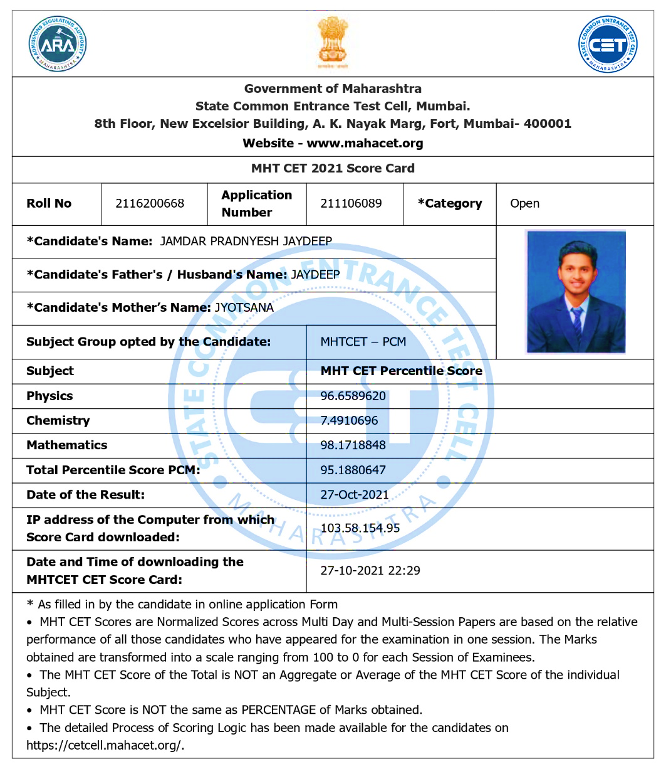
MHT-CET Score Card

Slide 74
State Rank of MHT-CET-2021
Sr. No. | Percentile | Rank Number
1 | 99.9 | 207
2 | 99.8 | 407
3 | 99.7 | 616
4 | 99.6 | 796
5 | 99.5 | 1003
6 | 99.4 | 1194
7 | 99.3 | 1397
8 | 99.2 | 1591
9 | 99.1 | 1785
10 | 99 | 1969
Sr. No. | Percentile | Rank Number
11 | 98.5 | 2951
12 | 98 | 3917
13 | 97.5 | 4906
14 | 97 | 5865
15 | 96.5 | 6810
16 | 96 | 7800
17 | 95.5 | 8787
18 | 95 | 9743
19 | 94 | 11,744
20 | 93 | 13,682
Sr. No. | Percentile | Rank Number
21 | 91 | 17,700
22 | 90 | 19,961
23 | 80 | 39,324
24 | 70 | 59,524
25 | 60 | 78,891
26 | 50 | 99,242
27 | 40 | 1,19,155
28 | 30 | 1,38,744
29 | 20 | 1,57,372
30 | 10 | 1,75,275

Slide 75
CAP 2020 SML Numbers
Sr. No. | Percentile | SML Number
1 | 99.9 | 118
2 | 99.8 | 238
3 | 99.7 | 387
4 | 99.6 | 540
5 | 99.5 | 665
6 | 99.4 | 820
7 | 99.3 | 933
8 | 99.2 | 1058
9 | 99.1 | 1212
10 | 99 | 1226
Sr. No. | Percentile | SML Number
11 | 98.5 | 2041
12 | 98 | 2748
13 | 97.5 | 3440
14 | 97 | 4245
15 | 96.5 | 4930
16 | 96 | 5635
17 | 95.5 | 6386
18 | 95 | 7083
19 | 94 | 8529
20 | 93 | 10081
Sr. No. | Percentile | SML Number
21 | 91 | 12968
22 | 90 | 14496
23 | 80 | 28553
24 | 70 | 40741
25 | 60 | 51016
26 | 50 | 59461
27 | 40 | 67005
28 | 30 | 73362
29 | 20 | 79120
30 | 10 | 84324

Slide 76
Cut Offs of Top Colleges

Slide 77
Last Year Cut Offs – CAP Round-I
College | CIVIL | COMP | IT | Electrical | ETRX | ETC | MECH | PROD
COEP | 1630 | 90 |  | 812 |  | 285 | 828
VJTI | 2511 | 88 | 169 | 1333 | 1054 | 497 | 1175 | 4385
SPIT |  | 238 | 387 |  | 2082 | 1351

Slide 78
Last Year Cut Offs – CAP Round-I
College | CIVIL | COMP | IT | Electrical | ETRX | ETC | MECH | PROD
SPCE | 5187 |  |  | 2979 |  |  | 2135
PICT |  | 546 669 | 1183 |  |  | 2408 2838
KJS |  | 3893 | 5357 |  |  | 10768

Slide 79
Last Year Cut Offs – CAP Round-I
College | CIVIL | COMP | IT | Electrical | ETRX | ETC | MECH | PROD
VIT |  | 1302 1456 | 1675 |  |  | 4070 4624 | 5509 6696 | 22622
WCE | 6225 | 1096 | 1604 | 4245 | 3743 |  | 3209
DJS |  | 933 | 1650 |  | 4959 | 4180 | 5919

Slide 80
Last Year Cut Offs – CAP Round-I
College | CIVIL | COMP | IT | Electrical | ETRX | ETC | MECH | PROD
CUMMINS |  | 2483 2987 | 3551 |  |  | 6786 8005 | 12653
PVG |  | 3450 | 4971 | 24343 |  | 14003 | 16964
GCEK | 10750 |  | 4748 | 10923 |  | 9617 | 8896

Slide 81
Centralized Admission Process (CAP) 2021-22

Slide 82
Steps in CAP 2021-22
Online Registration and Uploading of Documents
Document Verification and Confirmation of Application Form
Display of Merit List
Display of Seat Matrix
Filling of Option Form
Display of Seat Allotment
Online Seat Acceptance
Reporting to the College

Slide 83
Online Registration
Visit the Website: https://fe2021.mahacet.org
Create Login by using MHT-CET Roll Number
Fill Personal Details along with Mobile Number and e-mail Id
Application Id and Password will be sent to registered Mobile Number and e-mail Id
Login with Application Id and password
Select Type of Candidature

Slide 84
Type of Candidature
Sr. No. | Type of Candidature | Eligibility | Home University
1 | Type-A | Candidates passing SSC and also HSC or Diploma in Engineering Examination from a recognized institution in Maharashtra State; Candidate who is either Domicile of Maharashtra and/or is born in Maharashtra; | Place of passing of Qualifying Examination falling within the jurisdiction of the respective University area.
2 | Type-B | A Candidate who does not fall in Type-A above, but who or whose Father or Mother is domiciled in the State of Maharashtra and possesses Domicile Certificate. | Place of Domicile Certificate issuing authority falling within the jurisdiction of the respective University area.

Slide 85
Type of Candidature
Sr. No. | Type of Candidature | Eligibility | Home University
3 | Type - C | A Candidate who does not fall in either Type-A or Type-B but whose Father or Mother is an employee of the Government of India or Government of India Undertaking and who has been posted and reported to duty in Maharashtra State before the last date for submission of Application Form for CAP. | Place of posting of Father or Mother of Candidate falling within the jurisdiction of the respective University area.
4 | Type - D | A Candidate who does not fall in any of the above Type-A, Type B and Type-C but whose Father or Mother is an employee or retired employee of the Government of Maharashtra or Government of Maharashtra Undertaking. | Place of posting of Father or Mother of Candidate or the place of settlement of the Father or Mother if retired or the place of last posting if deputed outside Maharashtra falling within the jurisdiction of the respective University area.

Slide 86
Type of Candidature
Sr. No. | Type of Candidature | Eligibility | Home University
5 | Type - E | Passing SSC and/or HSC Examination from a recognized institution located in a disputed Maharashtra Karnataka Border Area or from Maharashtra, residing in the disputed Maharashtra Karnataka Border Area and whose Mother tongue is Marathi. | Candidate shall be considered for the Outside Home University or State Level Seats.

Slide 87
Online Registration
Fill Qualification Details: SSC, HSC/Diploma
Fill Category Details –
Open
SC/ST
OBC
SBC
VJ/DT
NT
Apply for TFWS – If you are eligible: Yes/No
Apply for EWS – If you are eligible: Yes/No
Apply for AI Seats – If Yes, Submit JEE (Main) Paper-I details
Upload Documents
Choose mode of document verification

Slide 88
Documents to be Uploaded
Sr. No. | Type of Candidate | Attested true copies of documents to be attached along with application form for admission to Engineering
01 | Type –A (Maharashtra State candidate) | SSC Mark sheet HSC Mark sheet School Leaving Certificate after passing XII/Diploma Certificate of Indian Nationality of the Candidate Domicile Certificate MHT-CET 2021 Mark sheet & JEE Mains (Paper I) 2021 Mark sheet (Online Print)
02 | Type –B (Domicile Status ) | Domicile certificate of candidate or of father/mother/husband In addition to documents mentioned in Sr. No. 01

Slide 89
Documents to be Uploaded
Sr. No. | Type of Candidate | Attested true copies of documents to be attached along with application form for admission to Engineering
03 | Type –C (Sons & Daughters of Central Govt./Govt. of India undertaking employee) | Certificate from the employer in Performa A In addition to documents mentioned in Sr. No. 01
04 | Type –D (Sons & Daughters of State Govt./ Govt. of Maharashtra undertaking employee) | Certificate from the employer in Performa B In addition to documents mentioned in Sr. No. 01
05 | Type –E (Maharashtra – Karnataka Border Candidates) | Performa G1 & G2 from school In addition to documents mentioned in Sr. No. 01

Slide 90
Documents to be Uploaded
Sr. No. | Type of Candidate | Attested true copies of documents to be attached along with application form for admission to Engineering
06 | SC / ST Candidates | Caste certificate Caste Validity Certificate In addition to documents mentioned in Sr. No. 01
07 | VJ / DT/ NT(A) / NT(B) / NT(C) / NT(D) / OBC/ SBC / Candidates | Caste certificate Caste Validity Certificate Non-Creamy Layer Certificate valid up to 31st March 2022 In addition to documents mentioned in Sr. No. 01
08 | EWS | Proforma-V In addition to documents mentioned in Sr. No. 01
09 | TFWS | Income Certificate of Parents (Annual Income below 8 Lacs) In addition to documents mentioned in Sr. No. 01

Slide 91
Document Verification and Confirmation
Application and Documents shall be Verified & Confirmed through–
E-Scrutiny mode
Physical Scrutiny mode
Verify Acknowledgement Receipt received from FC

Slide 92
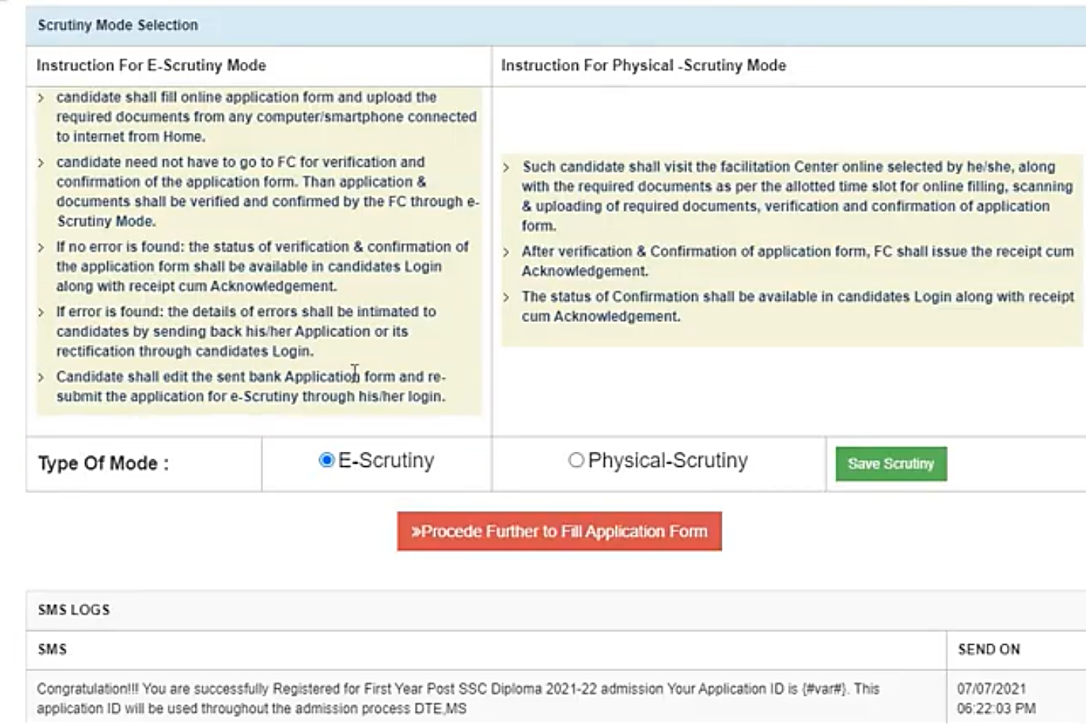
Document Verification and Confirmation

Slide 93
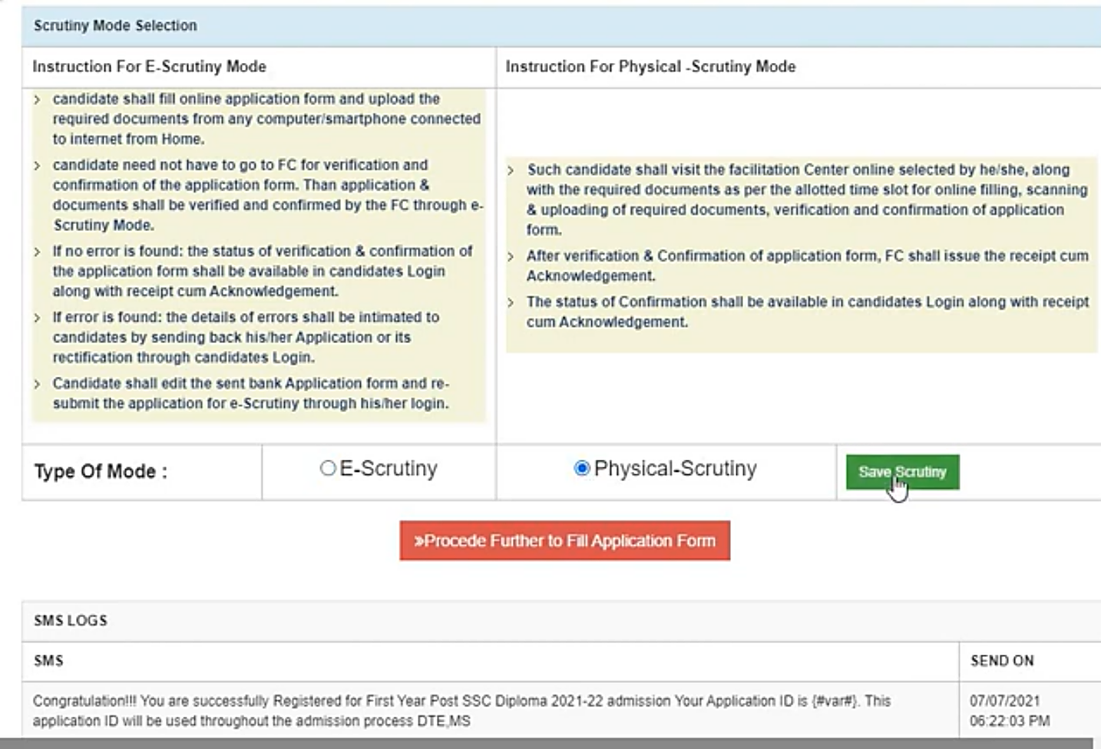
Document Verification and Confirmation

Slide 94
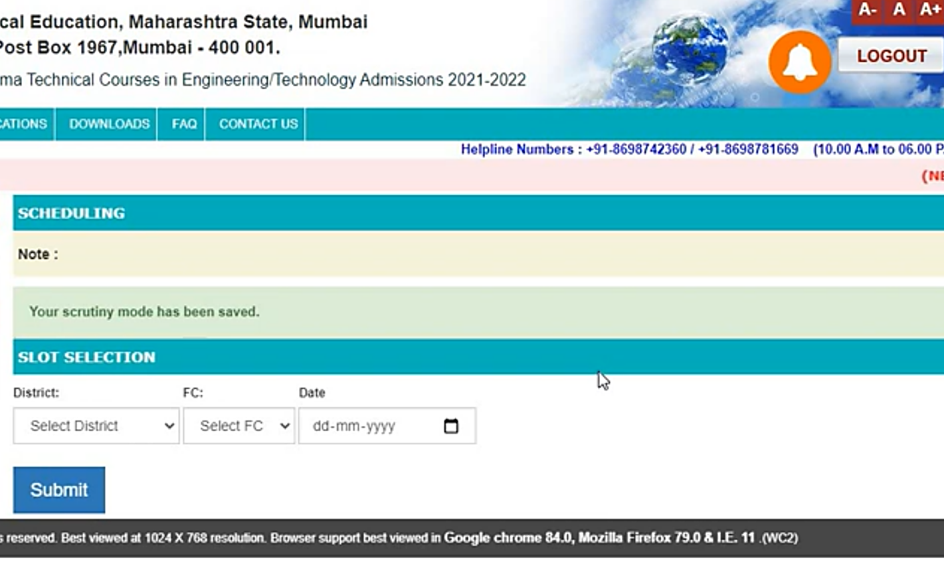
Document Verification and Confirmation

Slide 95
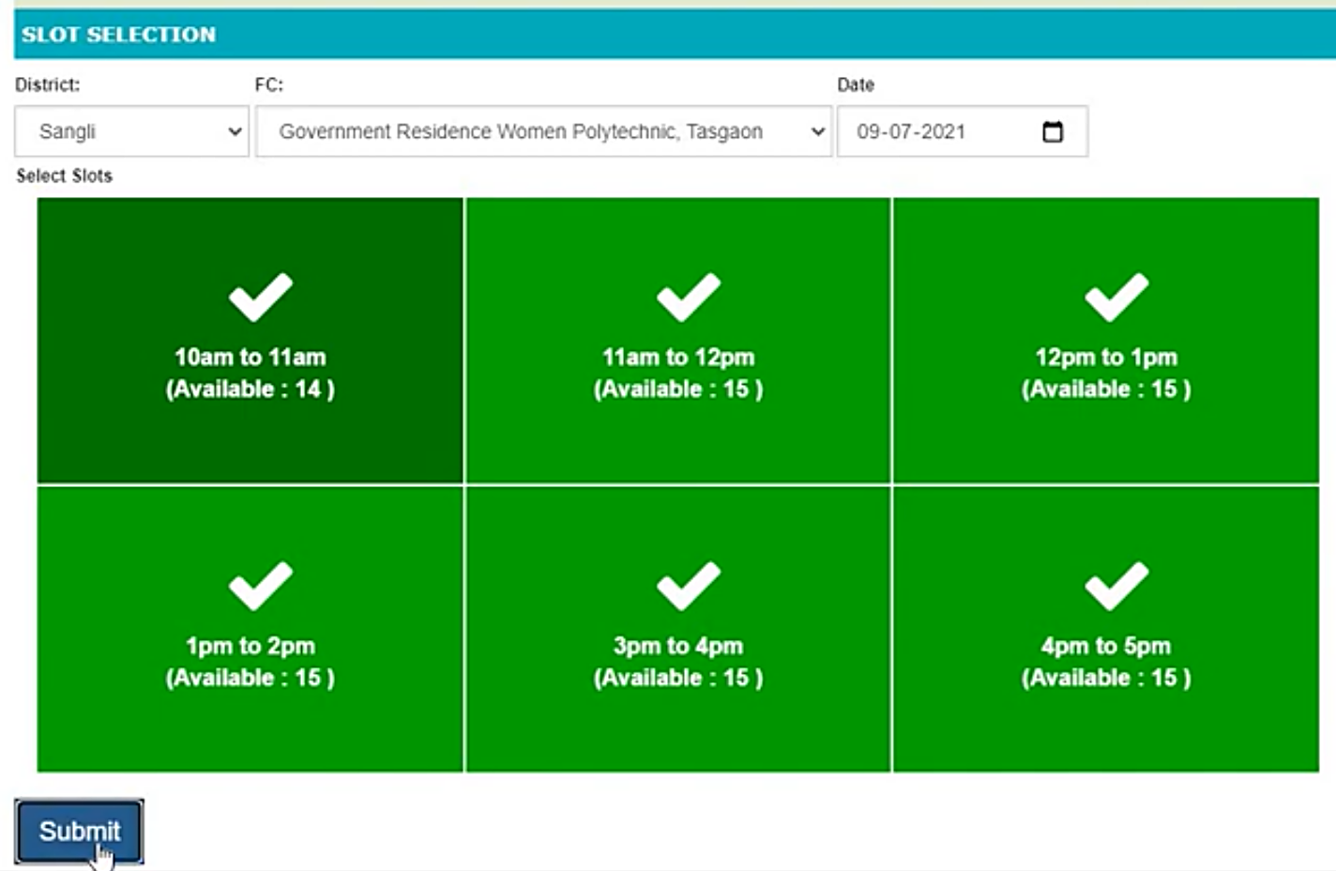
Document Verification and Confirmation

Slide 96
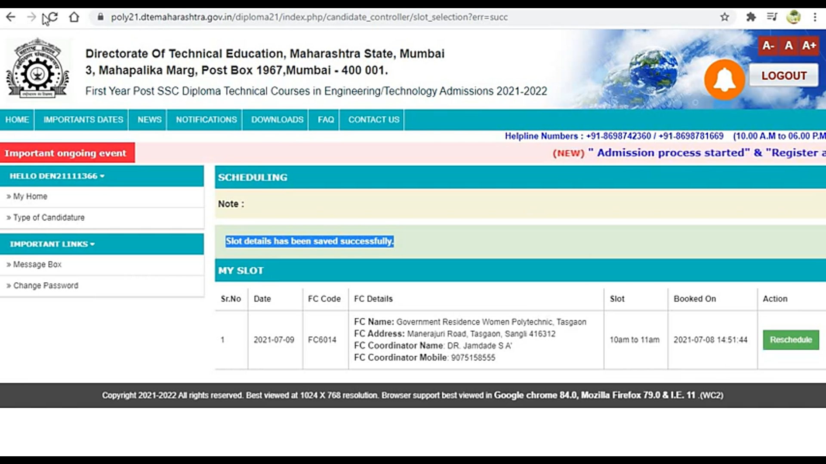
Document Verification and Confirmation

Slide 97
Display of Merit List
Display of Provisional Merit List
Check –
Personal Information
Gender
Type of Candidature
Category
Academic Details
If any grievance, raise query through candidate Login for rectification
Display of Final Merit List
Note down State Merit List (SML) Number

Slide 98
Homework Before Filling Option Form
Prepare List of Colleges and Branches as per Your Choice
Brainstorm your choices/options based on –
College or Branch
Fee
Type of College – Autonomous or Non-Autonomous
Location
Placements
Experienced Faculty
Infrastructure
Quality of Laboratories
Prepare Final List of Options

Slide 99
Filling Online Option Form for CAP Round-I
Fill Option Form online through Login ID
Minimum 1 and Maximum 300 options
First Option is Mandatory
Confirm Option Form using Password and OTP
Once option form confirmed, cannot be modified

Slide 100
Display of Seat Allotment
Check seat allotment status through login
See which option number is allotted –
If option number one is allotted, its mandatory to accept the seat
If option number allotted is other than one, Select –
Freeze OR
Betterment
If no seat is allotted, wait for CAP round-II

Slide 101
Seat Acceptance
The candidates allotted with First Option (Auto Freeze) –
Accept the seat through login
Pay Seat Acceptance Fee of Rs. 1000/- (Online)
Take printout of Seat Acceptance
Visit the allotted college, pay the fee, submit original documents and confirm the admission
Take Acknowledge Receipt of Admission Confirmation from the college

Slide 102
Seat Acceptance
The candidates allotted with other than first option –
Select any one of the two options –
Freeze
Betterment
If selected freeze option, then –
Accept the seat through login
Pay Seat Acceptance Fee of Rs. 1000/- (Online)
Take printout of Seat Acceptance
Visit the allotted college, pay the fee, submit original documents and confirm the admission
Take Acknowledge Receipt of Admission Confirmation from the college

Slide 103
Seat Acceptance
If selected Betterment option, then –
Accept the seat through login
Pay Seat Acceptance Fee of Rs. 1000/- (Online)
Take printout of Seat Acceptance
Wait for CAP round-II

Slide 104
Filling Online Option Form for CAP Round-II
Who are eligible for CAP Round-II -
Candidates who have not participated in CAP Round-I
Candidates who have not been allotted any seats in CAP Round-I
Candidates who have selected betterment option for the allotment of CAP Round-I
Candidates who have not accepted the seat allotment of CAP round-I

Slide 105
Filling Online Option Form for CAP Round-II
Fill option form online through login ID
Minimum 1 and Maximum 300 options
Confirm option form using password and OTP
Once option form confirmed, cannot be modified
Candidate who have selected Betterment Option for CAP round-I, allotted seat of CAP Round-I will be the last option automatically

Slide 106
Seat Acceptance for CAP Round-II
Candidates who have not accepted the seat in CAP Round-I OR Seat is allotted first time in CAP Round-II -
Accept the seat through login
Pay Seat Acceptance Fee of Rs. 1000/- (Online)
Take printout of Seat Acceptance
Visit the allotted college, pay the fee, submit original documents and confirm the admission
Take Acknowledge Receipt of Admission Confirmation from the college

Slide 107
Seat Acceptance for CAP Round-II
Candidates who have accepted the seat in CAP Round-I (Betterment) -
Visit the allotted college, pay the fee, submit original documents and confirm the admission
Take Acknowledge Receipt of Admission Confirmation from the college

Slide 108

Next Seminar -After Display of Merit List
What is your SML Number?
What is the meaning of University Rank, Category Rank, Gender Rank.
With the SML Number what best you can get.
How to refine your Selected Options?
Whether importance is to be given to branch or college.
How to fill option form?
How to confirm option form?
What is to be done after allotment?
How to do the seat acceptance?
How to confirm admission at the allotted college?
3rd Week of
November,
2021
Venue:
Seminar Hall, DYPCET,
Kasaba Bawada

Slide 109
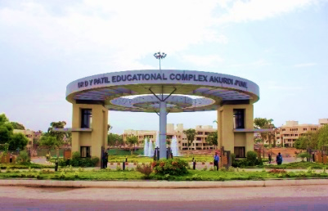
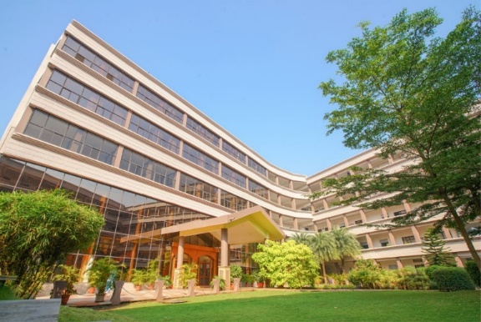
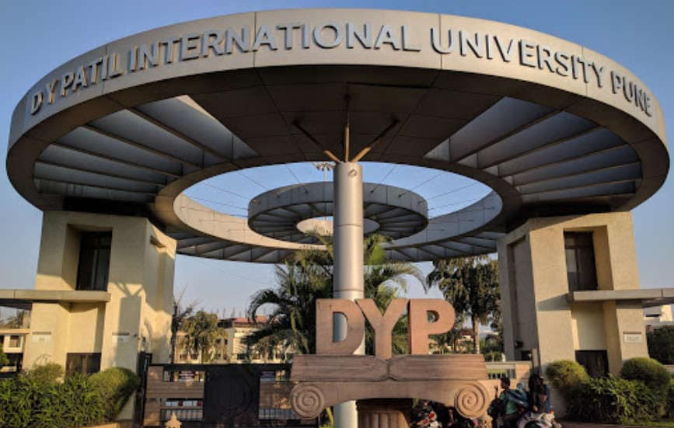

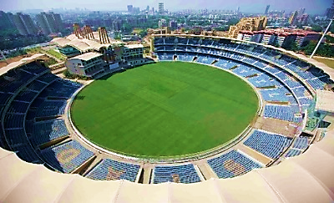
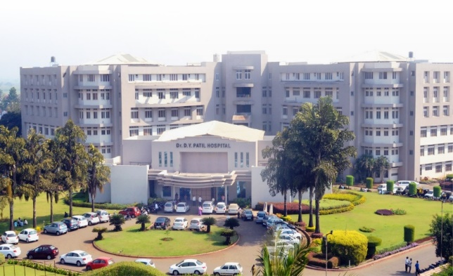
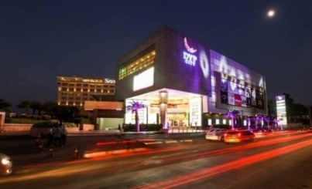
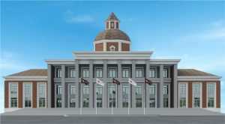
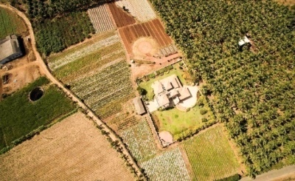
D. Y. Patil Group
Largest self-financed educational group in the state of Maharashtra
172 Institutes
Three Deemed Universities
Four State Private Universities
2.5 Lacs + Alumni
12,000+ Employees
3 Universities & 4 Institutes in NIRF 2021
Our Campuses :
Navi Mumbai
Akurdi, Pune
Pimpri, Pune
Lohegaon, Pune
Talegaon, Pune
Kasaba Bawada,Kolhapur
Talsande, Kolhapur
Salokhe Nagar, Kolhapur
Gargoti, Kolhapur

Slide 110
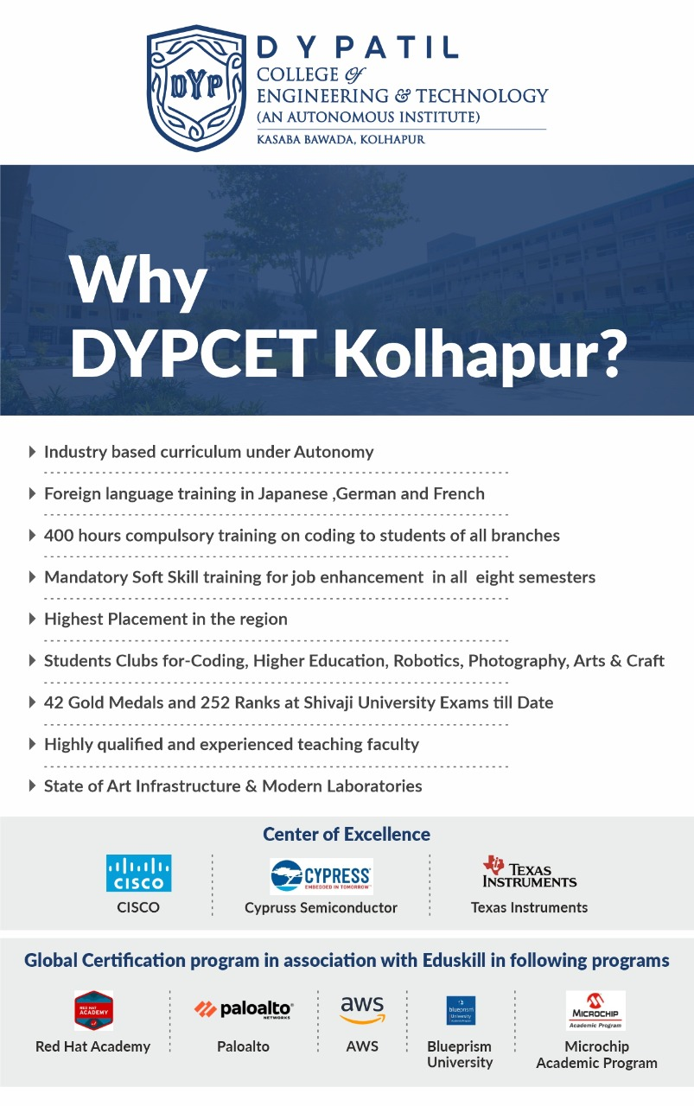
Why DYPCET (Autonomous), Kasaba Bawada?
Industry Based Curriculum Under Autonomy
Foreign Language Training in Japanese, German & French
400 Hours Compulsory Training on Coding to Students of all Branches
Mandatory Soft Skill Training for Job Enhancement in all Eight Semesters
Students Clubs for Coding, Higher Education, Robotics, Photography, Arts & Crafts
42 Gold Medals and 252 Ranks at Shivaji University Exams Till Date
Bus Facility from – Bhogavati, Sangli, Ichalkaranji, Kuditre, Kagal.

Slide 111


Why D. Y. Patil Technical Campus, Talsande ?
200+ Acres lush green campus
Well Equipped Laboratories
Effective Mentoring System for Personal Development of Students
50+ Companies Visiting for placement every year
Soft skill training to students
Entrepreneurship Development Cell
Indoor and outdoor facilities for sports
Well furnished hostel for Girls & Boys
Bus Facility from-
Kolhapur, Kagal, Sangli, Ichalkaranji, Islampur, Malakapur
Samruddhi TBI Incubation Center
Centre of Excellence for
Ethical Hacking & Information Security

Slide 112
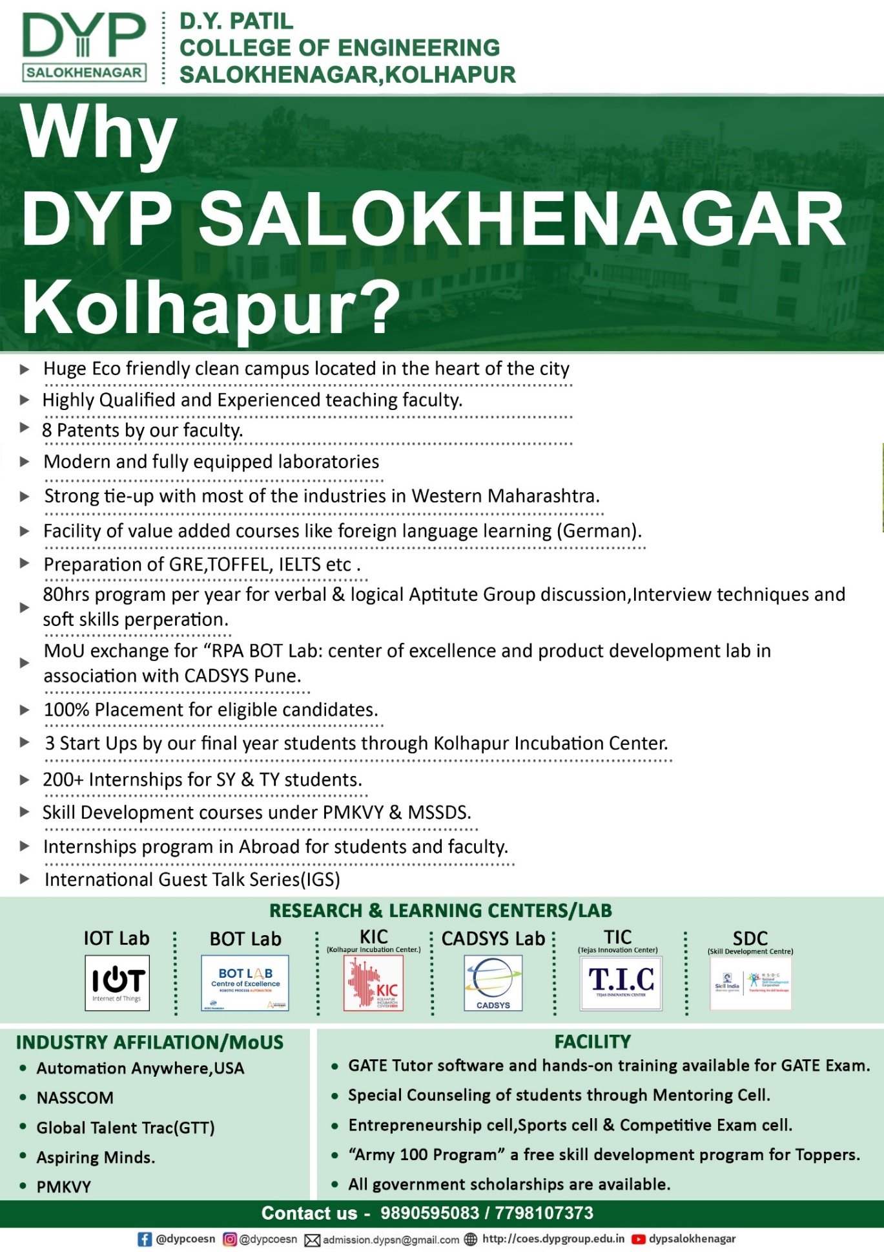
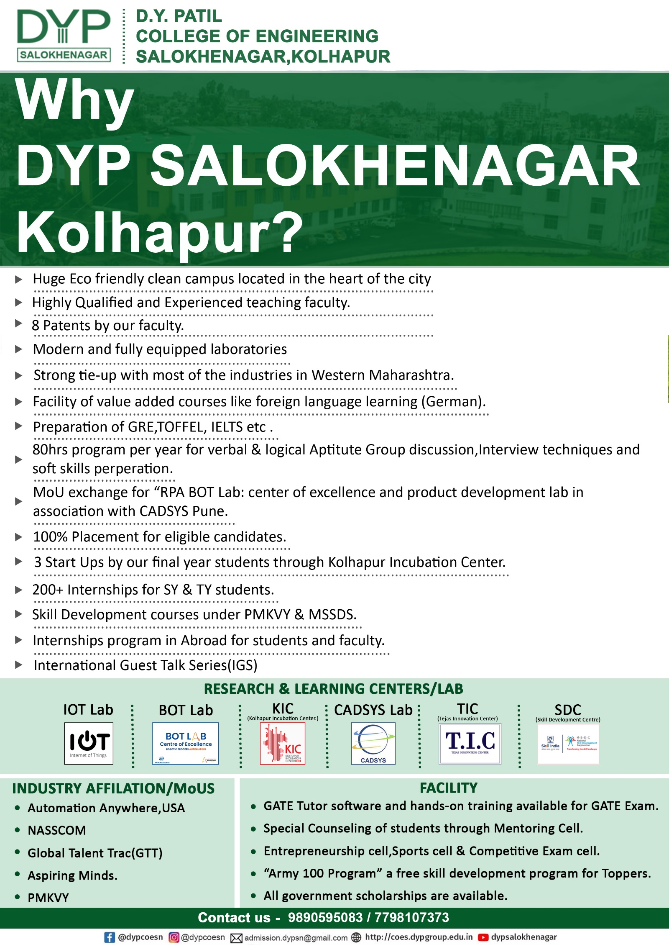
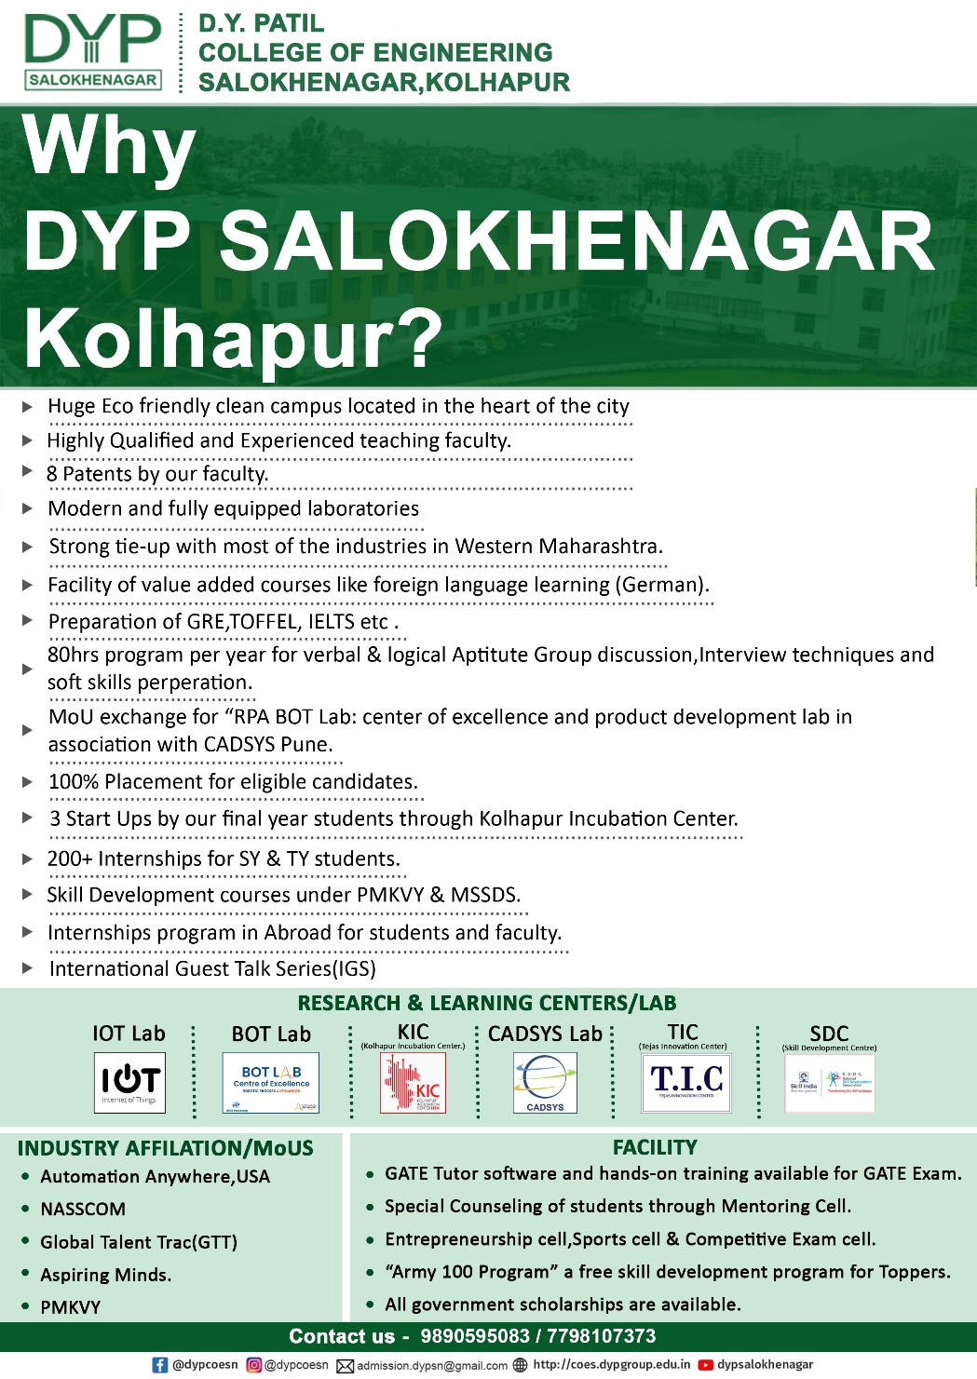
Why DYP Salokhenagar, Kolhapur?
Eco friendly clean campus located in the heart of the city
Modern and fully equipped laboratories
Strong tie-up with most of the industries in Western Maharashtra.
Facility of value added courses like foreign language learning (German)
Preparation of GRE,TOFFEL, IELTS etc.
MoU exchange for "RPA BOT Lab: center of excellence and product development lab in association with CADSYS Pune.
3 Start Ups by our final year students through Kolhapur Incubation Center
Skill Development courses under PMKVY & MSSDS
International Guest Talk Series(IGS)

Slide 113

37 Years of Excellence in Technical Education
Thank You

Slide 114


D. Y. Patil College of Engineering & Technology,
Kasaba Bawada, Kolhapur.
(An Autonomous Institute)
9158915999 / 9158615999
D. Y. Patil Technical Campus,
Talsande.
8329798890 / 9860618828
Dr. D Y Patil Pratishthan's College of Engineering, Salokhenagar, Kolhapur.
9890595083 / 7798107373
D. Y. Patil Agriculture and Technical University,
Talsande.
9699339917 / 9699330619

